Slide 1
ERS AI assistant
Tool to enhance user experience and increase cross-sale opportunity

Slide 2
Pain point to address
Tune around time is long when client have issue/question.
Not able to find reference product document.
Not able to update client how the new product /release can help client address their issue regulary
Didn’t have a knowledge base to store the issue/case
Train partner on resolving simple product issue

Slide 3
ERS AI assistant is your private client success assistant
Utilize the latest AI technology to support client in area below
Capture the data issue and help client detect unqualify data in early stage
Provide product document and other reference information when client has question
Recommend the latest ma solution which relevant to client at the end of the document/reference
Online version can detect the user emotional, redirect the enquire to client success manager before esculation

Slide 4
Addition feature
End user can trigger calculation via chatting with the assistant. It can help to reduce the MA operation cost on backing cloud adhoc run.
End user can also generate data profile report via the assistant.
Offline version also available for client with intranet access only( assistant will try to convert the client to Banking cloud and cross sale MA product)

Slide 6
Below is how to implement (for technical audience)
Use vector database as knowledge to store the metadata embedding
Embedding can reduce the cost on training/using open ai without impacting the return.
Assess control also possible to limit the content that user can retrieval from the knowledge.
A knowledge catcher in batch start from dev to capture the issue in the whole product lifecycle.
User/partner can also add in their own private knowledge.

Slide 7
How to store the knowledge
Store Product document embedding into vector db.
1
Store basic API usage embedding into vector db
2
Store basic product data requirement( like table_constraint) into vector db
3
Thus user/partner can interact with chatbot to know when facing basic issue.
4

Slide 8
How to store the knowledge(continue)
When there are new issue/data, the batch can generate related embedding into the vector db.
Vector tagging can be use as uam control to limit the information to different user.

Slide 9
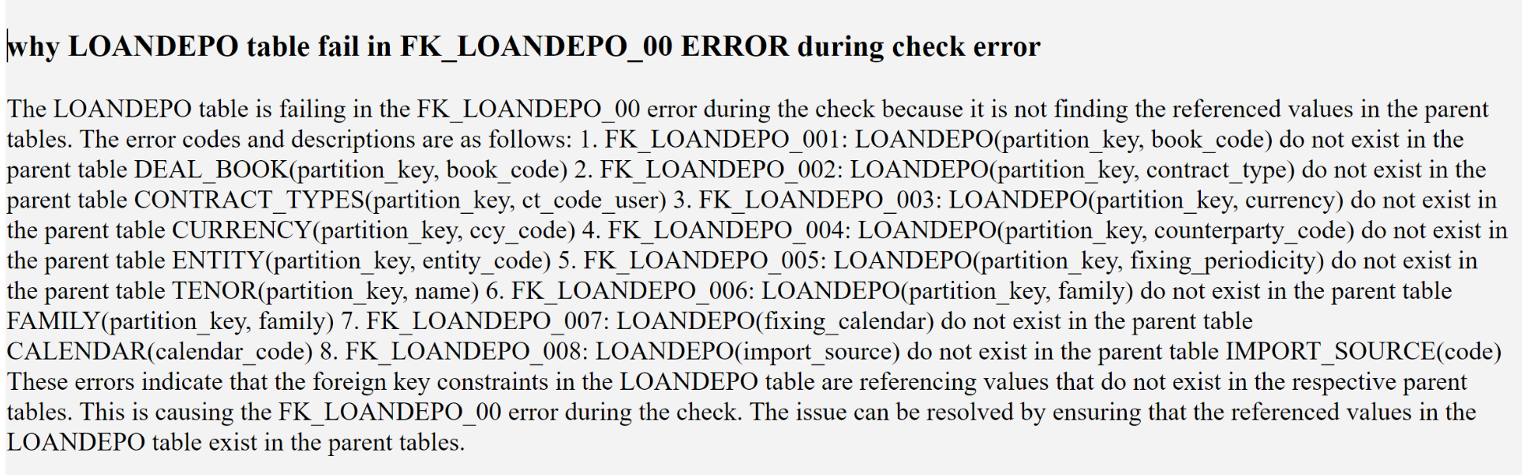
Feature
Online Partner support chatbot
A general chat tools( web/slack/etc) to answer partner question.
It can save MA resource from helping partner on doing first level simple issue trouble shoot.(like missing check error/ no free space/ etc)
prototype

Slide 10
Online project support chatbot/
A project level vector knowledge base to store the project knowledge/version/change in backend.
The front can make use of openai to query the knowledge to help project member ( MA team/ partner/Client) to maintain the knowledge.
Pain point to address:
Client user/IT rotate on and off. And the knowledge didn’t have internal handover and lead to no one understand the data logic.
Easier to compare two set of configuration via diff the config in text format.

Slide 11
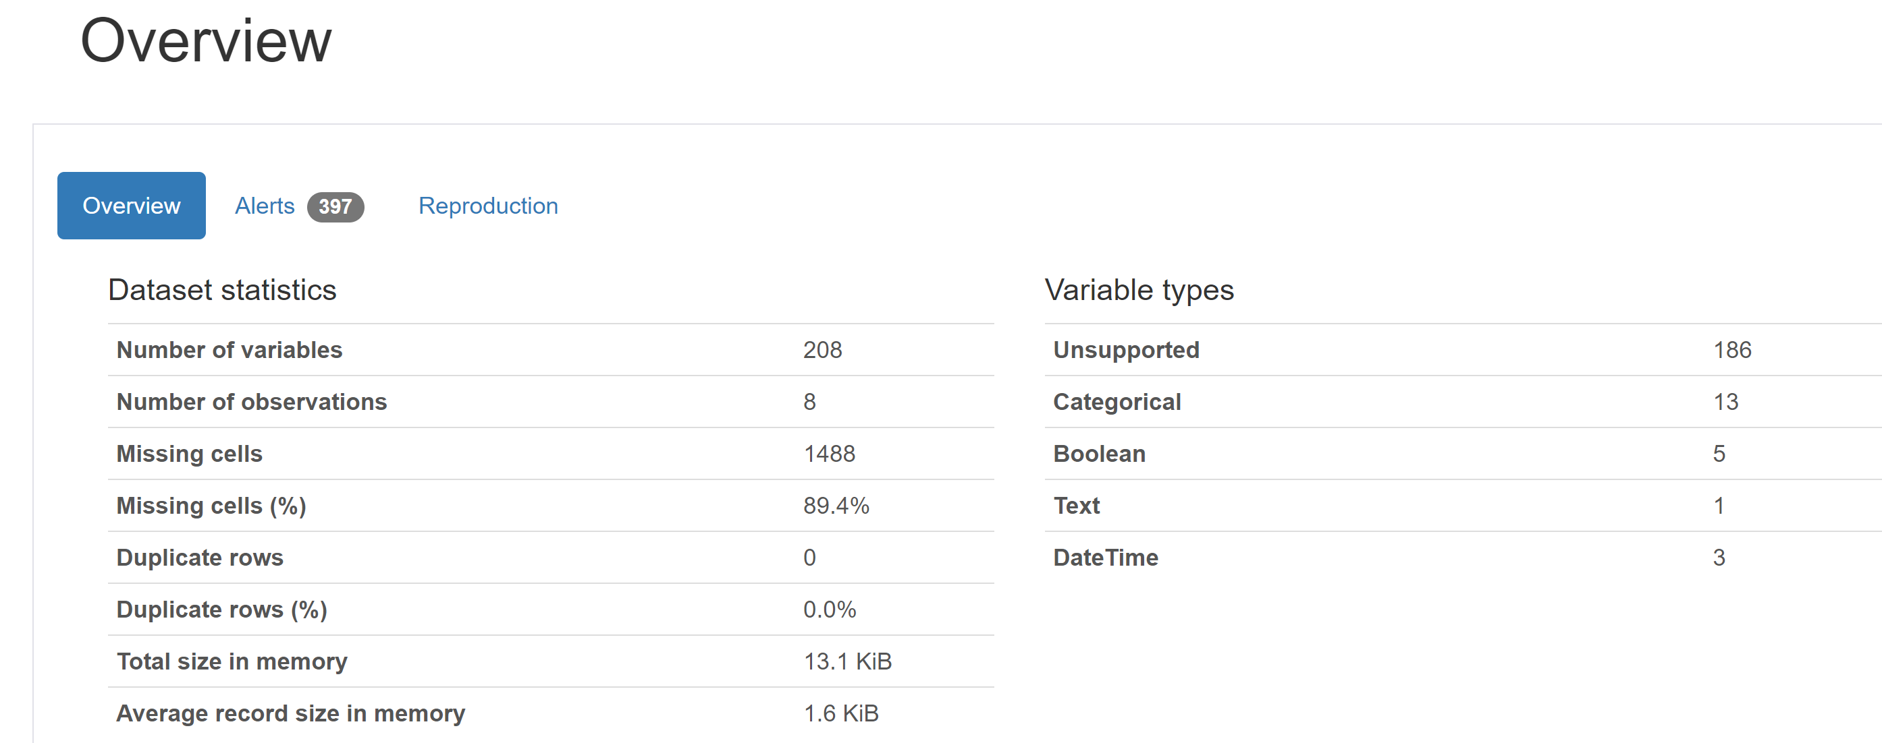
Data quality
Online /offline data quality precheck tools
Data profile report
Client /partner can detect the data issue in early stage rather than wait for data upload to BC , run ETL and crash the run or whole file got rejected

Slide 12
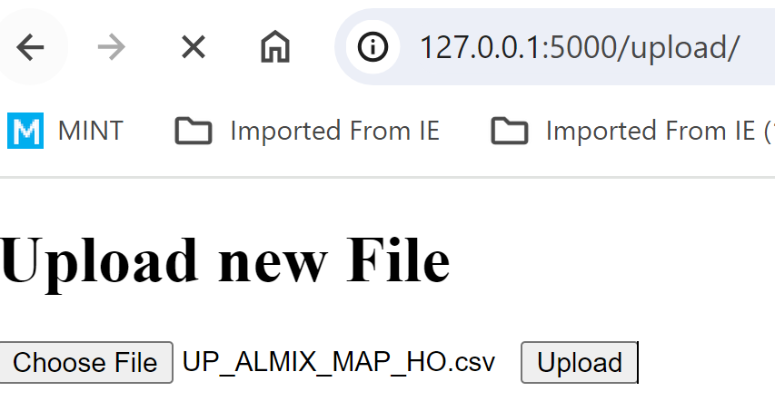
choose target table
Upload file
Generate data profile html
Generate constraint recommendation
Generate data quality report

Slide 13
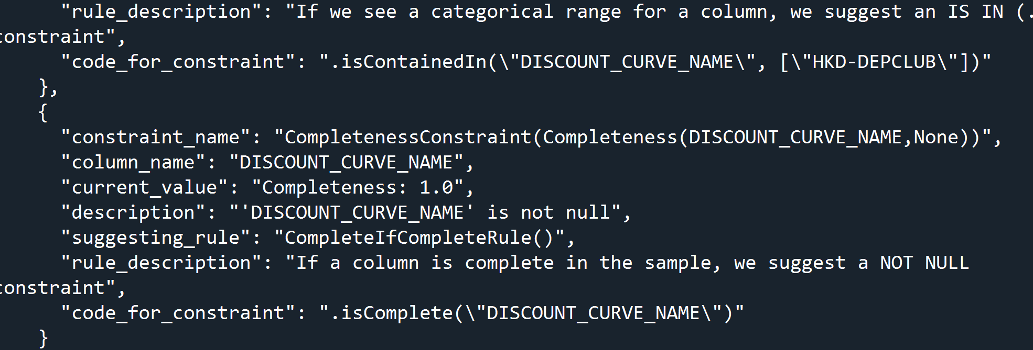
Data patching recommendation
Make use of the AI data quality power to auto generate the constraint recommendation without knowing the RFO/BC rule
Base on the BC data requirement to recommend the default value for invalid data

Slide 14
How to convert product pdf document to embedding
Place pdf document set in folder
Generate file list
Load file as bytes
Convert file to text
Split file by page / sentences
Store embedding and the related info to vector db
Generated embedding

